Slide 1
Learning Outlook

Slide 2
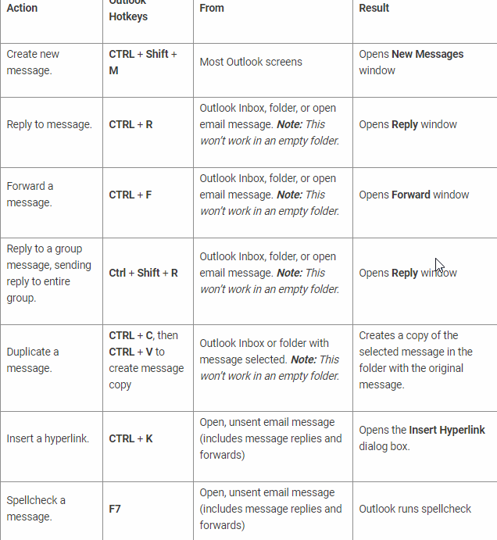

Slide 3
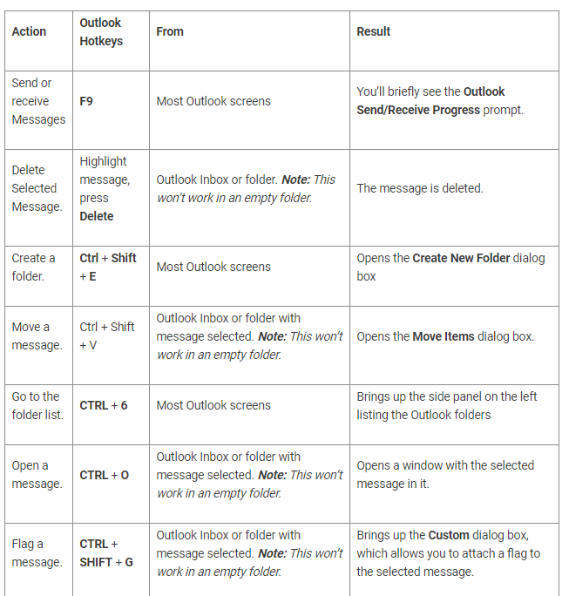

Slide 4
